Slide 1

2025 Summer Parent Meeting

Slide 2
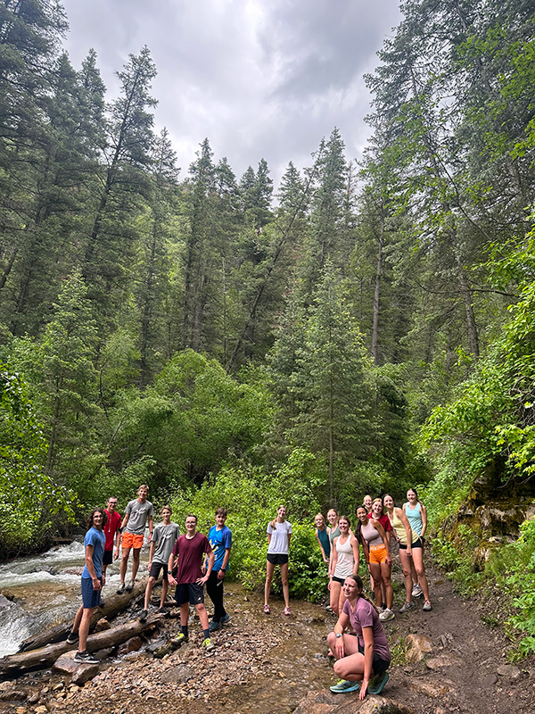
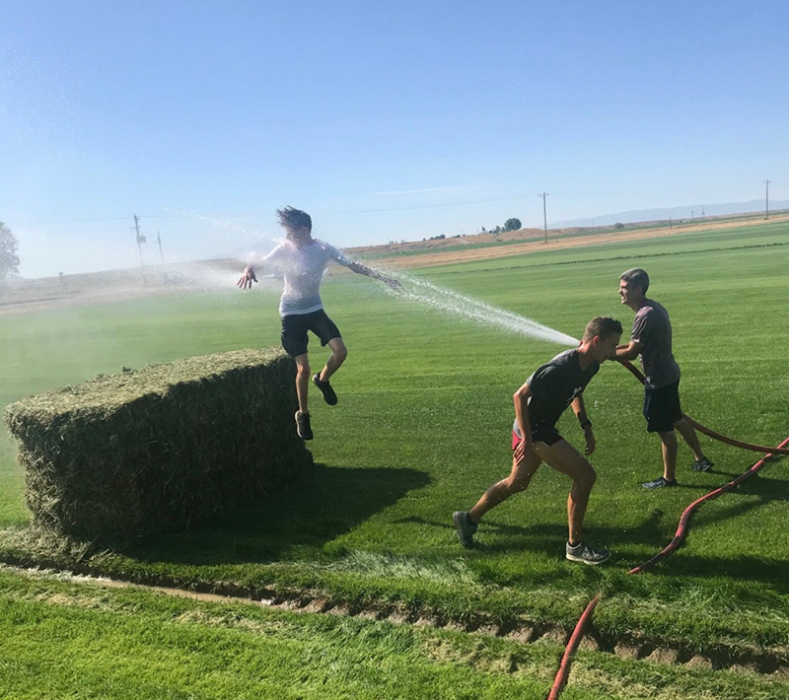
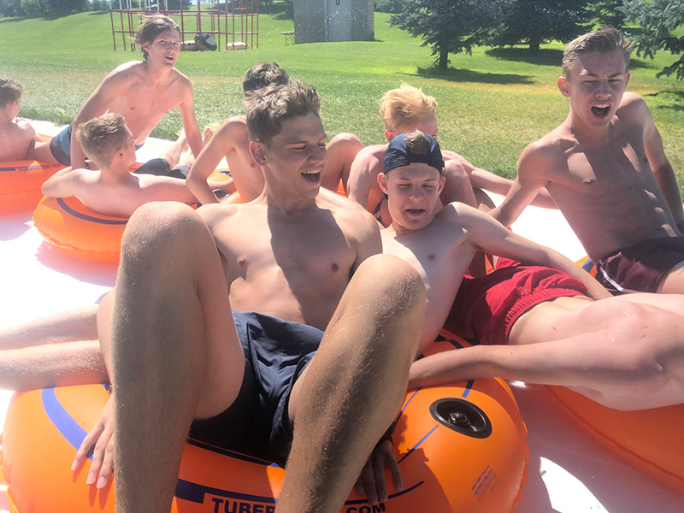
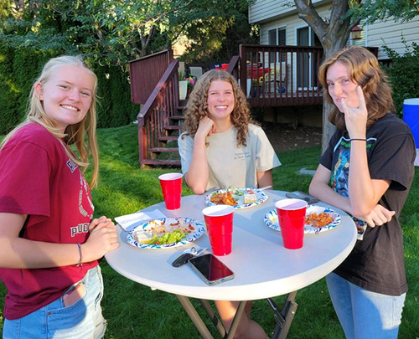
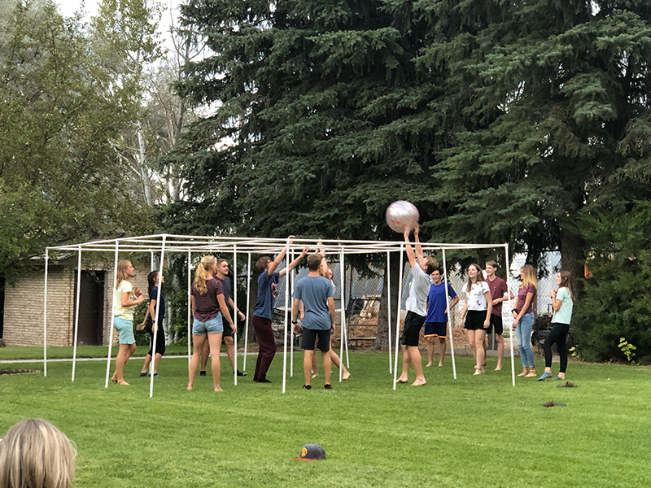
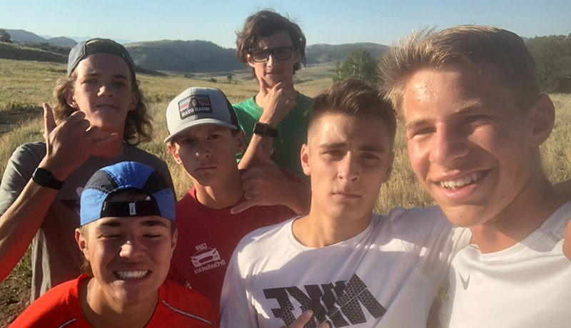

Slide 3
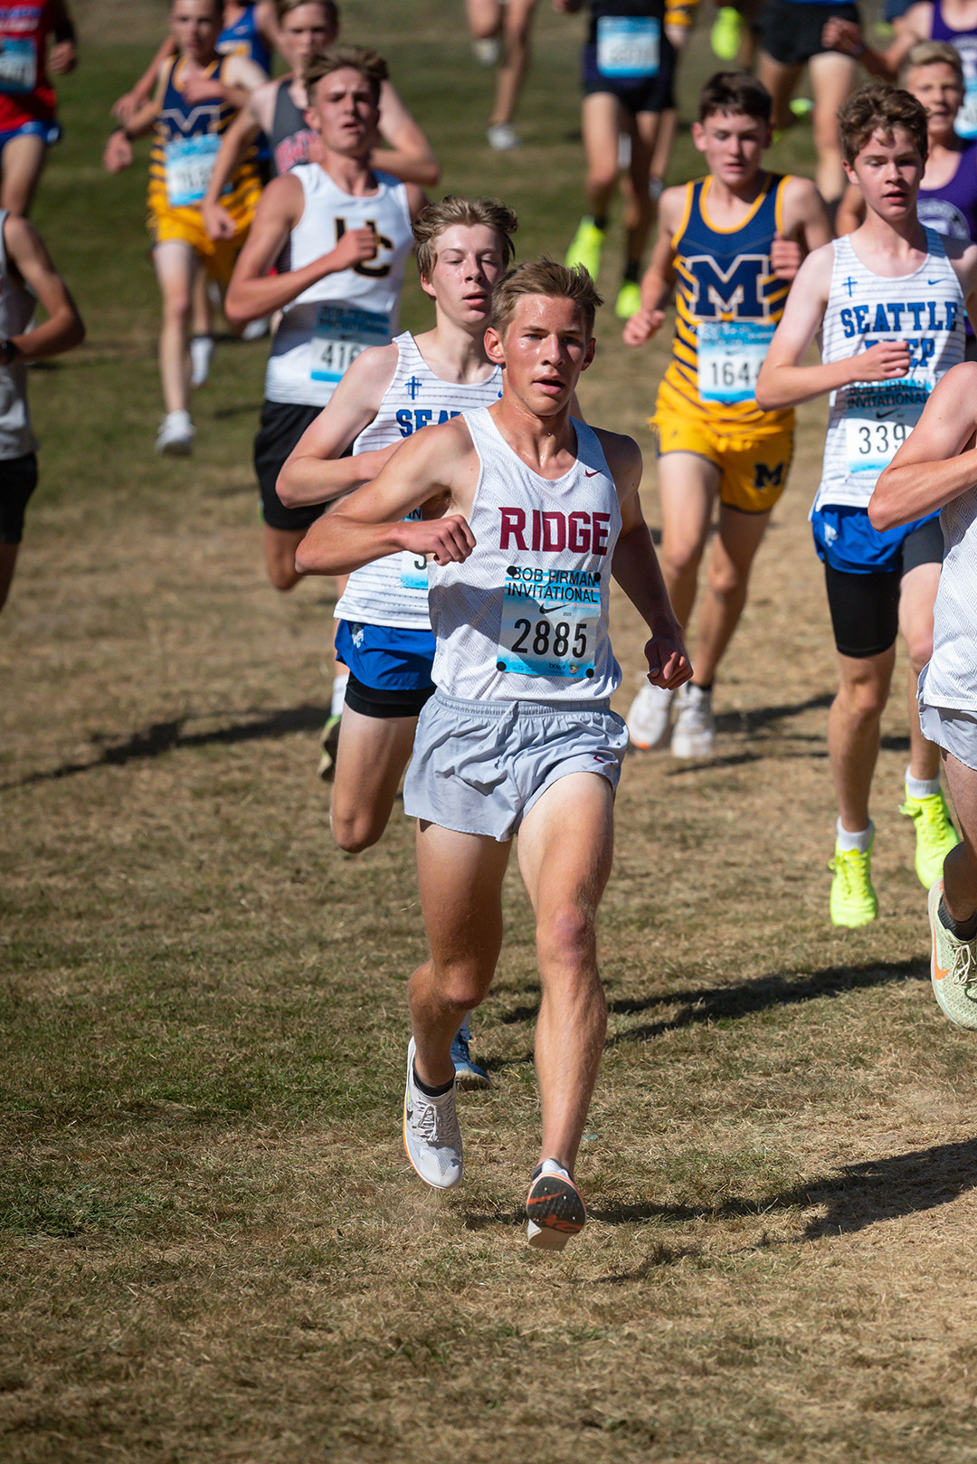
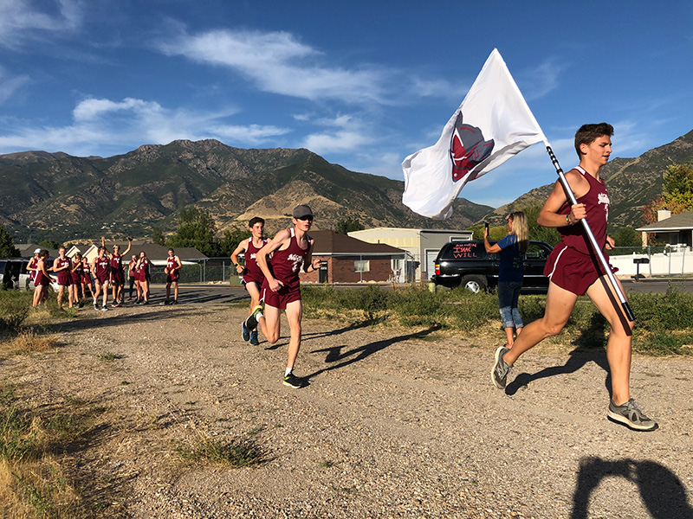
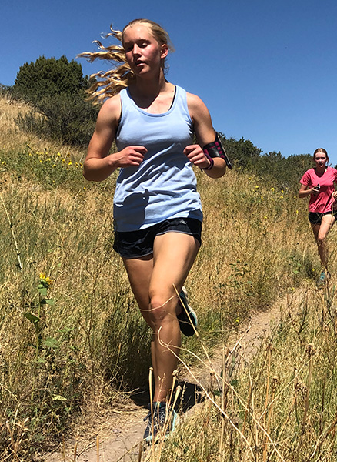
And we run, too…

Slide 4
Introductions
Coaches
  Coach Bentley
  Coach Hutchinson
  Coaches Hazard (Cambria & Tyson)
  Coaches Tueller (Steve & Camille)
  Coach Shelley
Captains
  Eva Cowan (Senior)
  Jane Jeffrey (Junior)
  Natalie Agren (Senior)
  Parker Ewell (Senior)
  Stephen Bentley (Senior)
  Jeffrey Hazard (Junior)

Slide 5
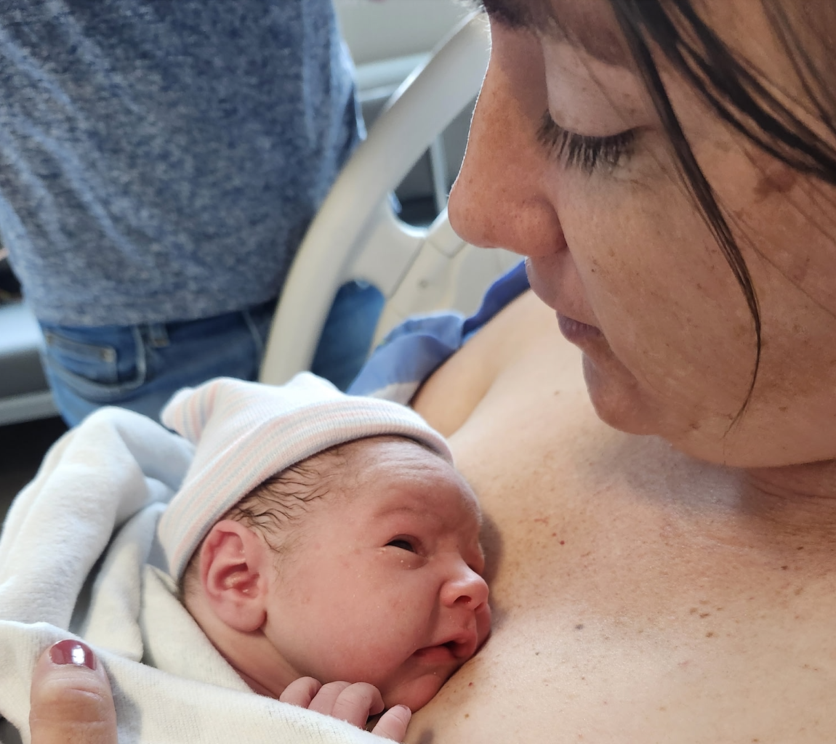
WELCOME, MCKAY!!

Slide 6
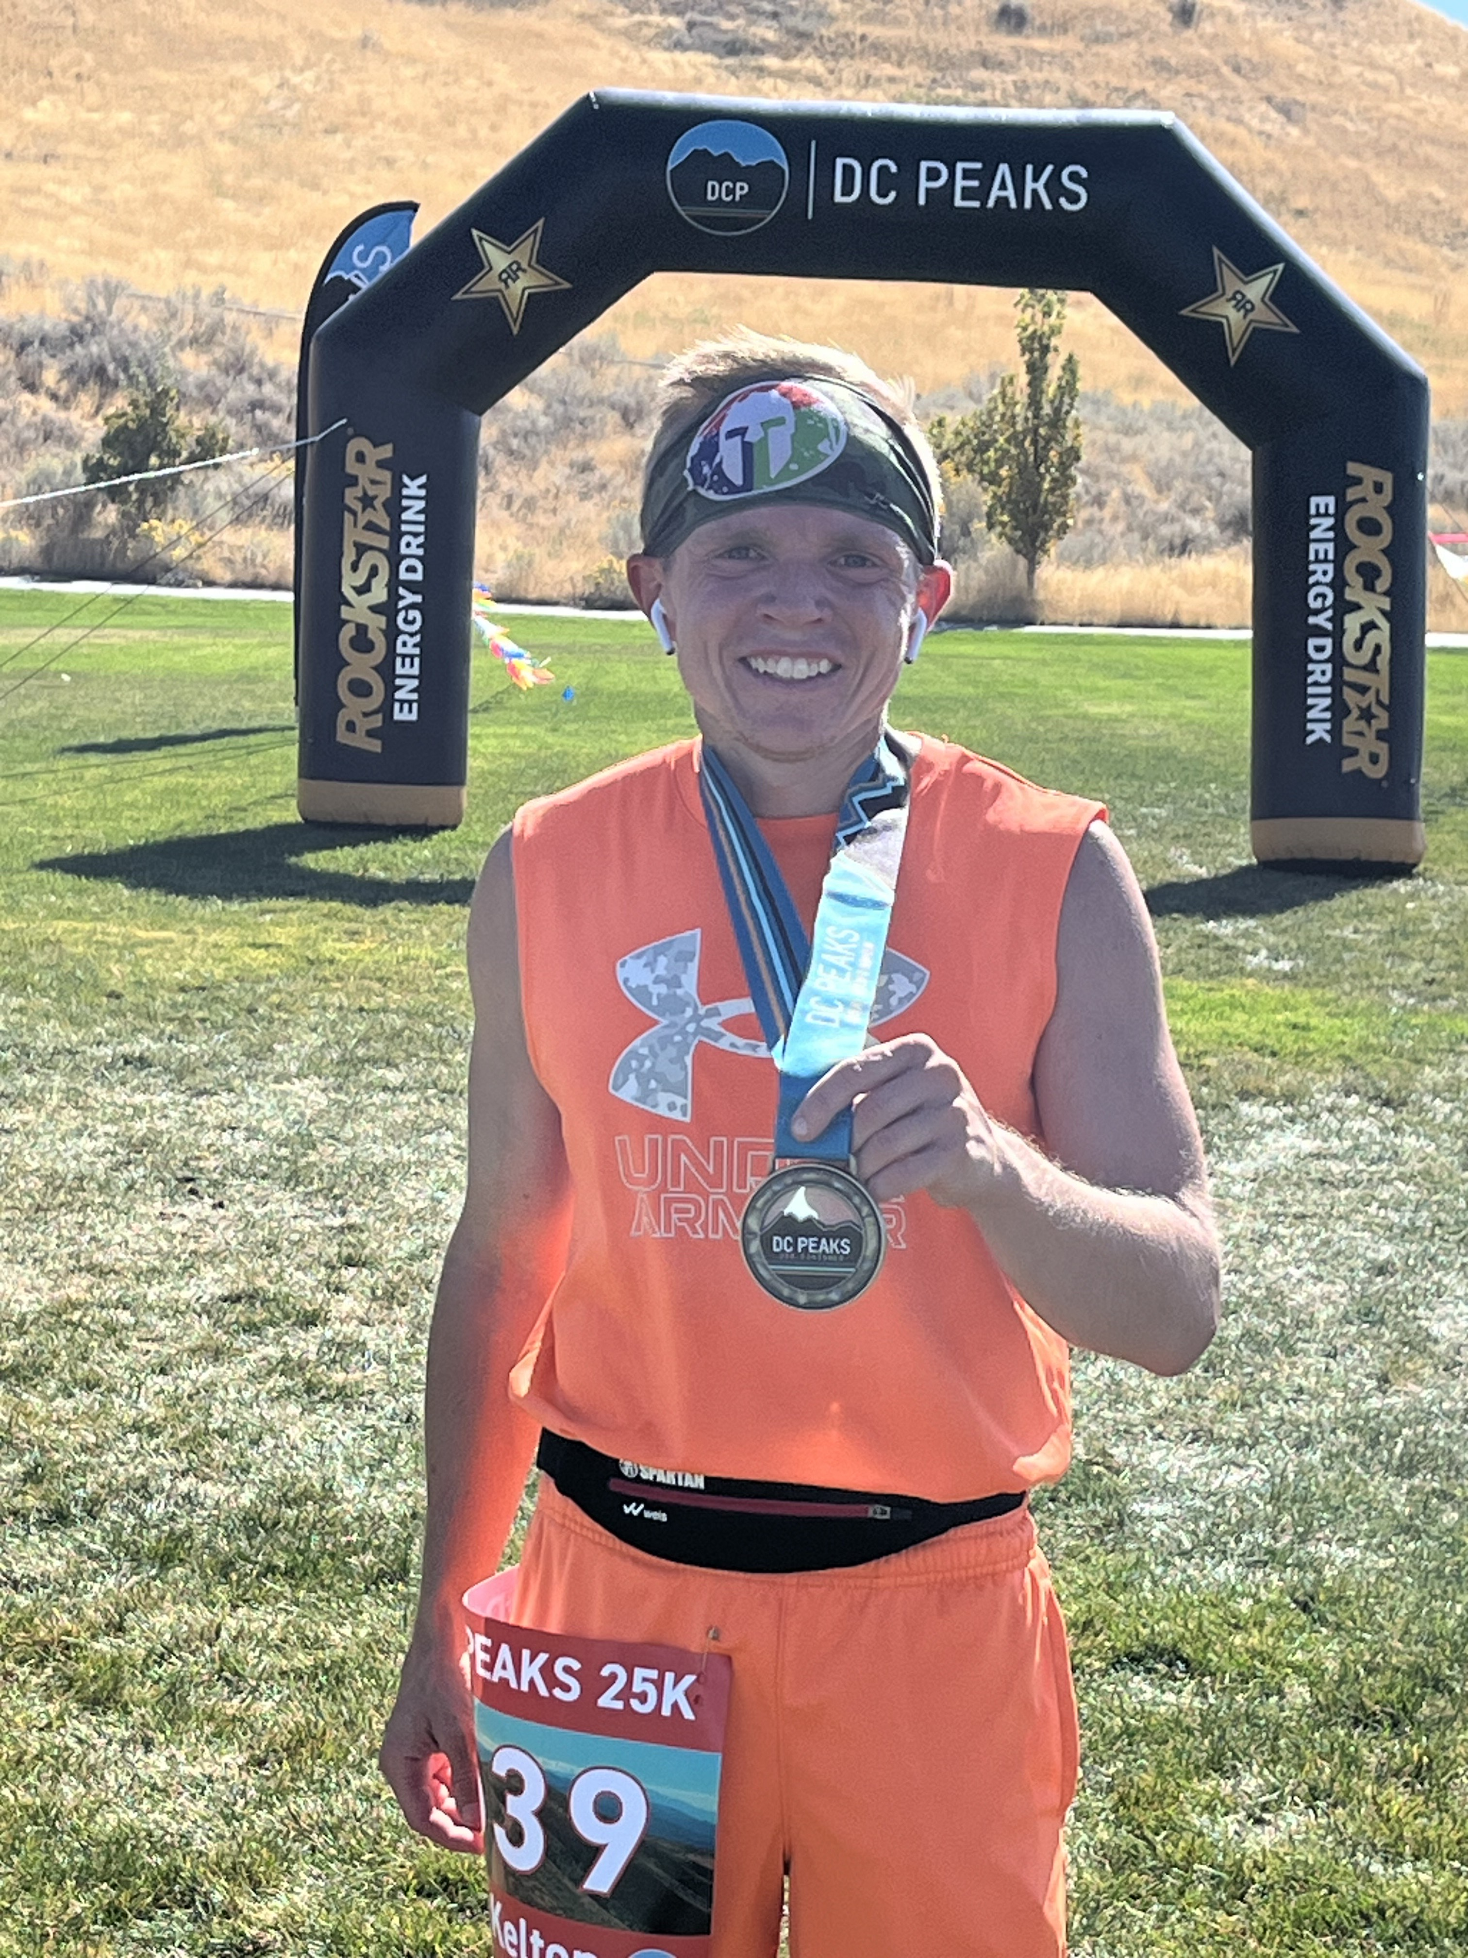
Kelton Shelley
NASM Certified Personal Trainer
Completed over 85 Races in just over 4 years (everything from 5Ks to Marathons, Spartans, Ultramarathons, and Triathlons)
Former Lacrosse Coach
Current Coach at VASA Fitness
I’m excited to work with each and every one of you this season! I love the mental aspect of endurance sports and I am excited to help you see your full potential in a variety of ways this season I want to help you be able to push forward when it feels impossible because I know that you can!

Slide 7
ALL INFORMATION WILL BE POSTED ON THE TEAM WEBSITE: https://northridgexc.com/2025-nrxc-summer-training-parent-meeting-information/
ELIGIBILITY | COMMUNICATION | TEAM FEES | EQUIPMENT | SUMMER TRAINING SCHEDULE & EXPECTATIONS
FUNDRAISING | CROSS-COUNTRY CAMP | OUT-OF-STATE MEETS | VOLUNTEERING | KEY DATES &. CHECKLISTS
NUTRITION & HYDRATION | ENCOURAGEMENT AND SUPPORT

Slide 8
ELIGIBILITY
Academic Eligibility
  Based on prior term grades (so, 4th term 2023-2024)
  Must have had a GPA of at least 2.0 during the last term AND
  Must not have had more than one F grade.
Please come talk to me if you think there may be issues. It’s better to get out in front of things when possible.
Age Eligibility (Summer Training)
  Anyone who is going into 7th grade or higher is welcome to come run during the summer, but they cannot compete with the team until they are in 9th grade.
Age Eligibility (In-Season Practice & Competition)
  9th-12th graders can practice and compete with the team during the season.

Slide 9


COMMUNICATION
Parents (GroupMe)
Athletes (Band)
Install the appropriate app, create an account, and then scan the QR code.

Slide 10
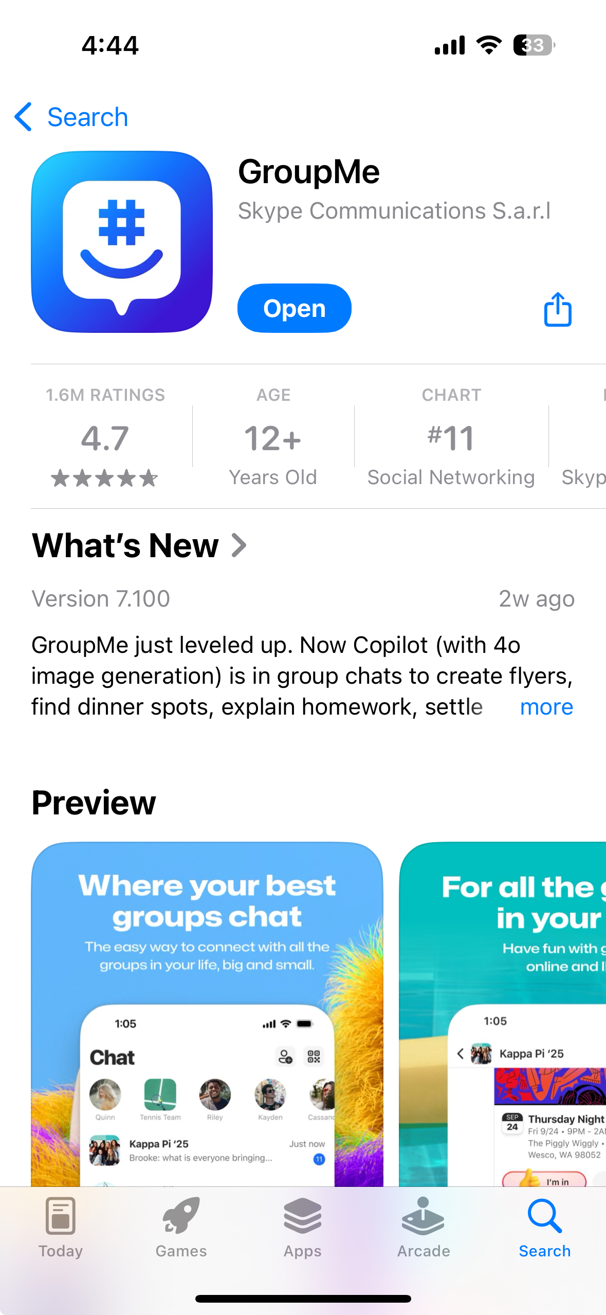


Slide 11
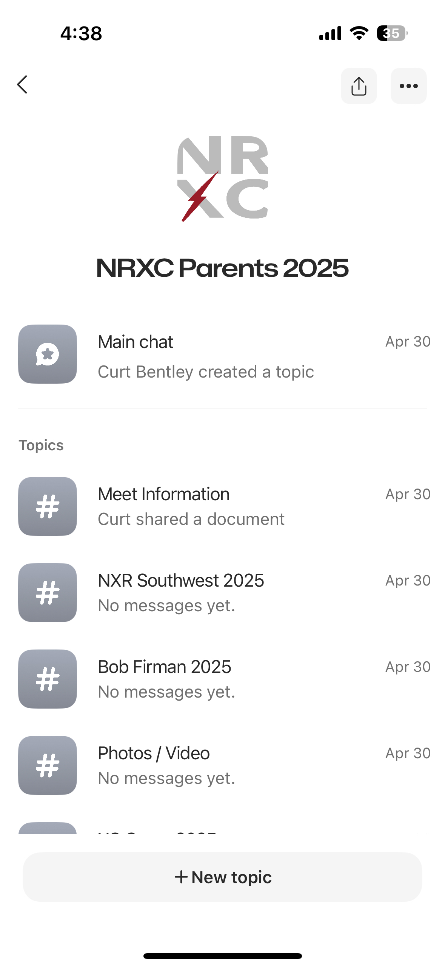
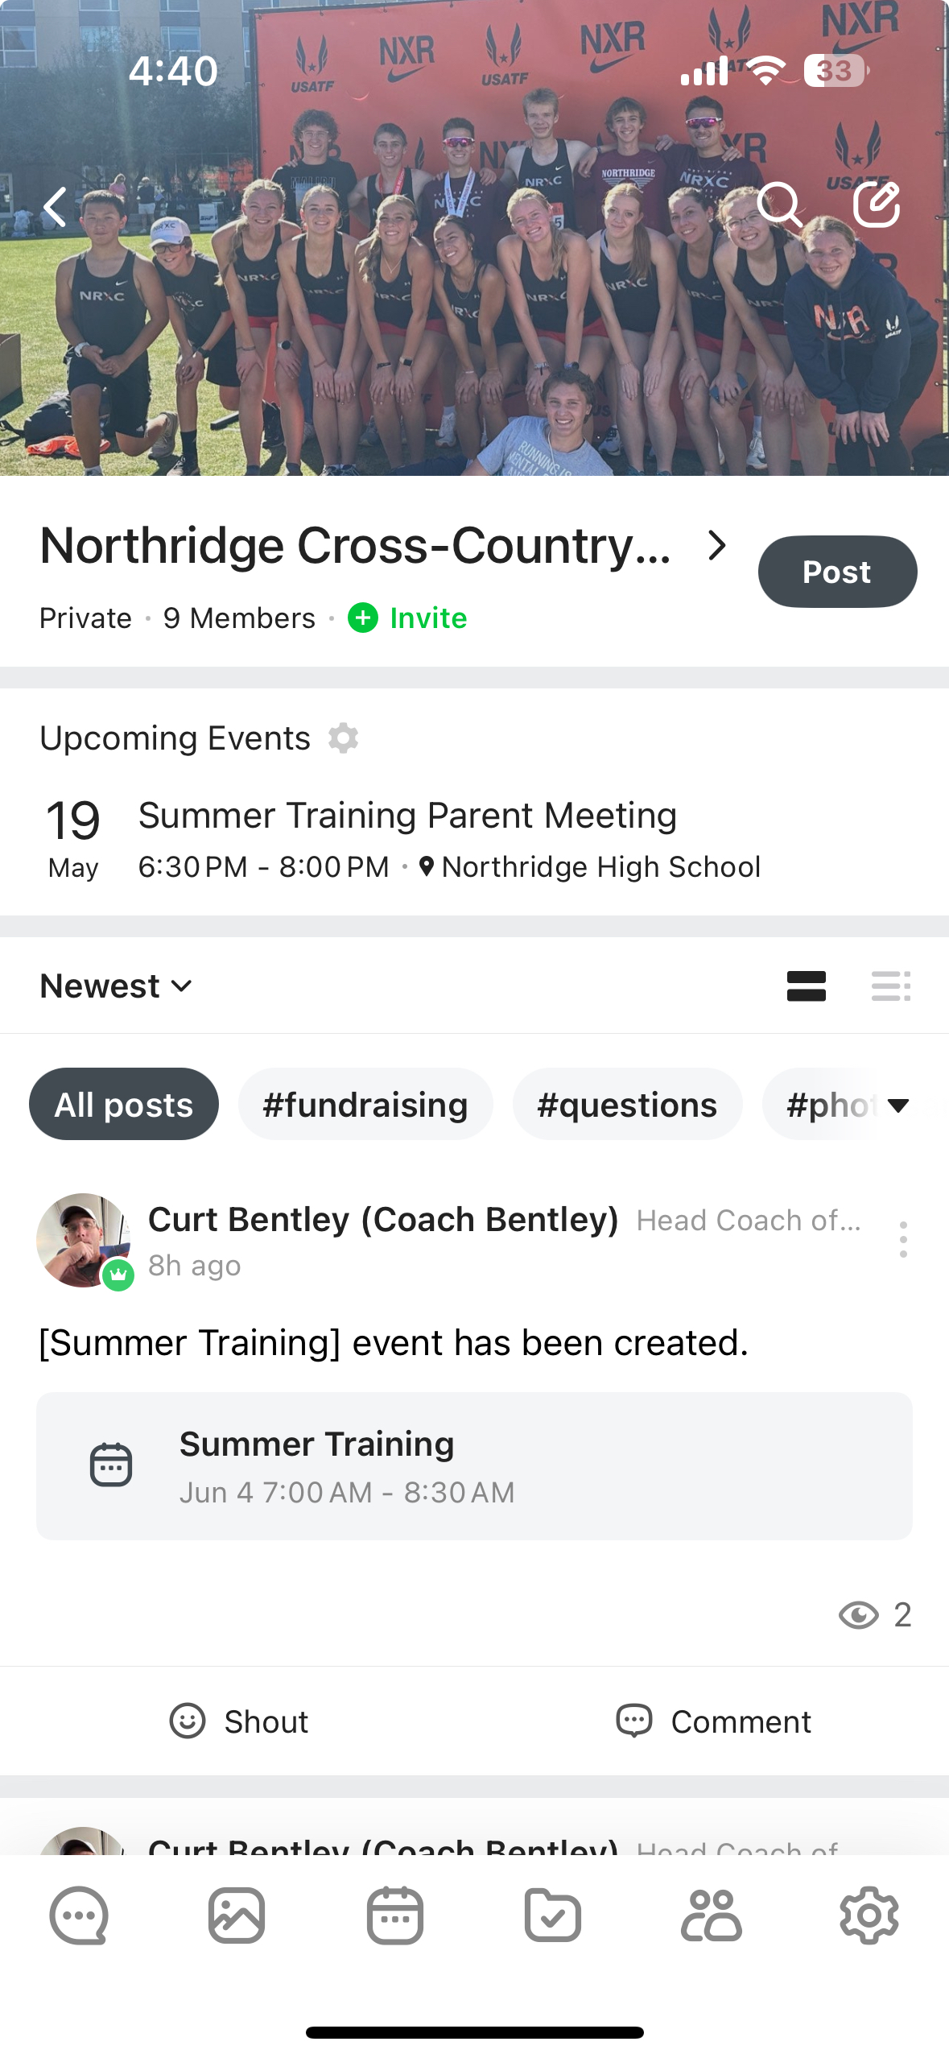

Slide 12
TEAM FEES
Summer Training
  Optional donation
  Paid through club, tax deductible, Venmo being set up
Cross-Country Camp
  Will discuss more later
  4 day/3 night camp
  Cost likely around $120
  Paid through club
In-Season Team Fee
  Exact amount undetermined, probably around $150 total
  Not assessed until start of the season
  Paid through school
Out of State Meets
  These meets are optional
  Athlete responsible to cover travel, lodging, and food costs
  Likely paid through club

Slide 13
EQUIPMENT
Required Equipment
Running shoes
  Must be running specific
  Do not have to be fancy
  Don’t need more than one pair of shoes
  Don’t need spikes
  Financial assistance available
Training clothes
  Do not need to be fancy or expensive.
  T-shirt, tank top, shorts, sports bra for female athletes
Water bottle
Watch
  Does not need to be a GPS watch but must be able to time intervals; Garmin discount
Optional Equipment
Team gear
  Team store (will notify when it opens)
  Nothing required
  Season’s use of uniform for competition will be included in the team fee
Other running accessories
  Running socks
  Massage gun, foam roller
  Heart rate monitor
  Hats, sunglasses, socks

Slide 14
SUMMER TRAINING (RUN SCHEDULE)
Team Runs
Meet Monday through Friday
  Start June 2, 2025, 7:00 AM @ NHS
  Variable locations
  Schedule will be posted on the website
Optional Saturday Long Run
  Every other week; variable locations
  Will sometimes meet at NHS to carpool
Sunday is a Rest Day
Other Activities
  Coach catch, watchless runs, water fights, scavenger hunt, Pineview day, Thursday night lights, homecoming relay, hunger games
Individual Training
Saturday
  On weeks with a team long run, optional to join
  On weeks without a team long run, athletes train on their own or in a group with runners of their same gender
Sunday is a Rest Day
  Seriously! We want them to rest
  Talk to me if individual adaptation is required

Slide 15
SUMMER TRAINING (Speed and Form Camp)
Speed & Form Camp
Start of Summer Training to UHSAA Moratorium
  Twice per week, starting June 3 (Tue/Thurs)
  At Northridge
All runners will participate
  Focus is on development of speed and power and good running form
  Games and treats
  Goals are to have team members get to know each other and to focus on getting athletes running right before starting to get fit

Slide 16
SUMMER TRAINING (STANDARD EASY RUNS)
Team Runs
Monday, Wednesday, Friday Until UHSAA Moratorium (June 27-July 4)
  Newer runners are welcome each day, or welcome to only come on Tue/Thurs/Friday during the first month
  Goal is to get all runners running consistently
  New runners should focus on running 4-5 days per week with low mileage
  Experienced runners should build to running 6 days per week and then increase mileage
Monday Through Friday after UHSAA Moratorium (June 27-July 4)
  Schedule is variable, but there is a general pattern
  Mondays @ Fernwood, Tuesdays & Thursdays @ Northridge, Wednesdays @ Weber River Trail, Fridays @ Oak Forest Park, and Saturdays either on your own or at other location.
  Occasionally the Thursday/Friday locations may be adjusted. That is on the calendar and will be announced at the beginning of the appropriate week.
  CARPOOL

Slide 17
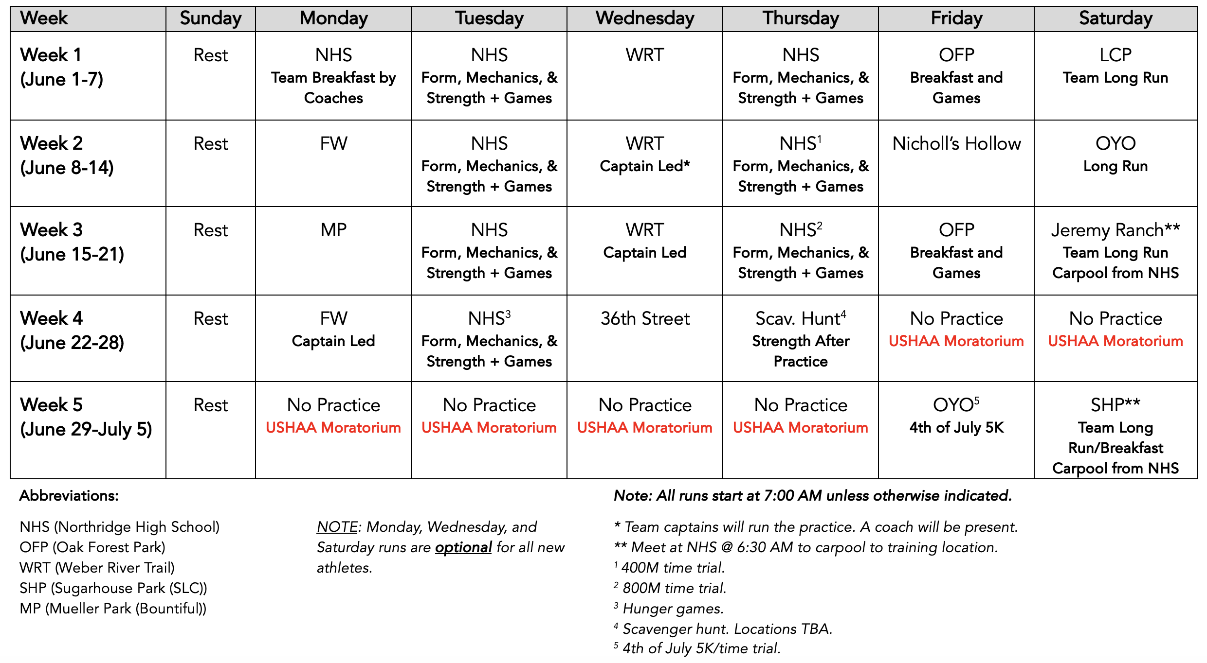

Slide 18
SUMMER TRAINING (STRENGTH SCHEDULE)
Strength Training (for runners??!)
  Essential for injury prevention
  Performance enhancing
  Develops well-rounded athleticism
  Does not have to be lifting weights
  Does not have to be long or super intensive
  Not trying to turn them into weightlifters or stunt growth
Schedule
Designed Sessions
  Athletes should do programmed sessions from the team
NHS Weight Room
  We have the weight room reserved after practice on Tuesdays through the summer for team strength work
Bodyweight Alternatives
  We will have an alternative bodyweight program that can be done at home
30-45 Minute Sessions

Slide 19
Summer TRAINING (EXPECTATIONS)
Attendance & Participation
When in town and available, I expect athletes to be at team training sessions
Be on time!
We understand that jobs, vacations, and other obligations will require missing training
Varsity runners are expected to attend team Saturday long runs
Communicate!
Speed & Mileage
No requirement that you run a certain pace or mileage
We will evaluate runners during the first week of training, meet with them, and jointly set mileage goals for the summer
Strength Training
All athletes do strength training
Runners hate it, but it is a difference maker
Tracking Mileage and Communication
Athletes are expected to track mileage daily and report it weekly (required for XC camp and mileage rewards)
Each athlete will report mileage weekly through a Google Form
Each athlete will have an assigned day each week to meet with a coach after practice and discuss the last week’s training
Without regular communication to coaches, it is difficult for us to coach effectively

Slide 20

SUMMER TRAINING (STRAVA)
Strava is an app used to track endurance activities such as running or cycling
I encourage all team members to use Strava
It’s helpful for coaches to keep track of what athletes are doing
It’s helpful for athletes to track progress
It’s fun for most, but if it starts causing anxiety athletes can stop using it
You can use it without a GPS watch
We have a team Strava group

Slide 21
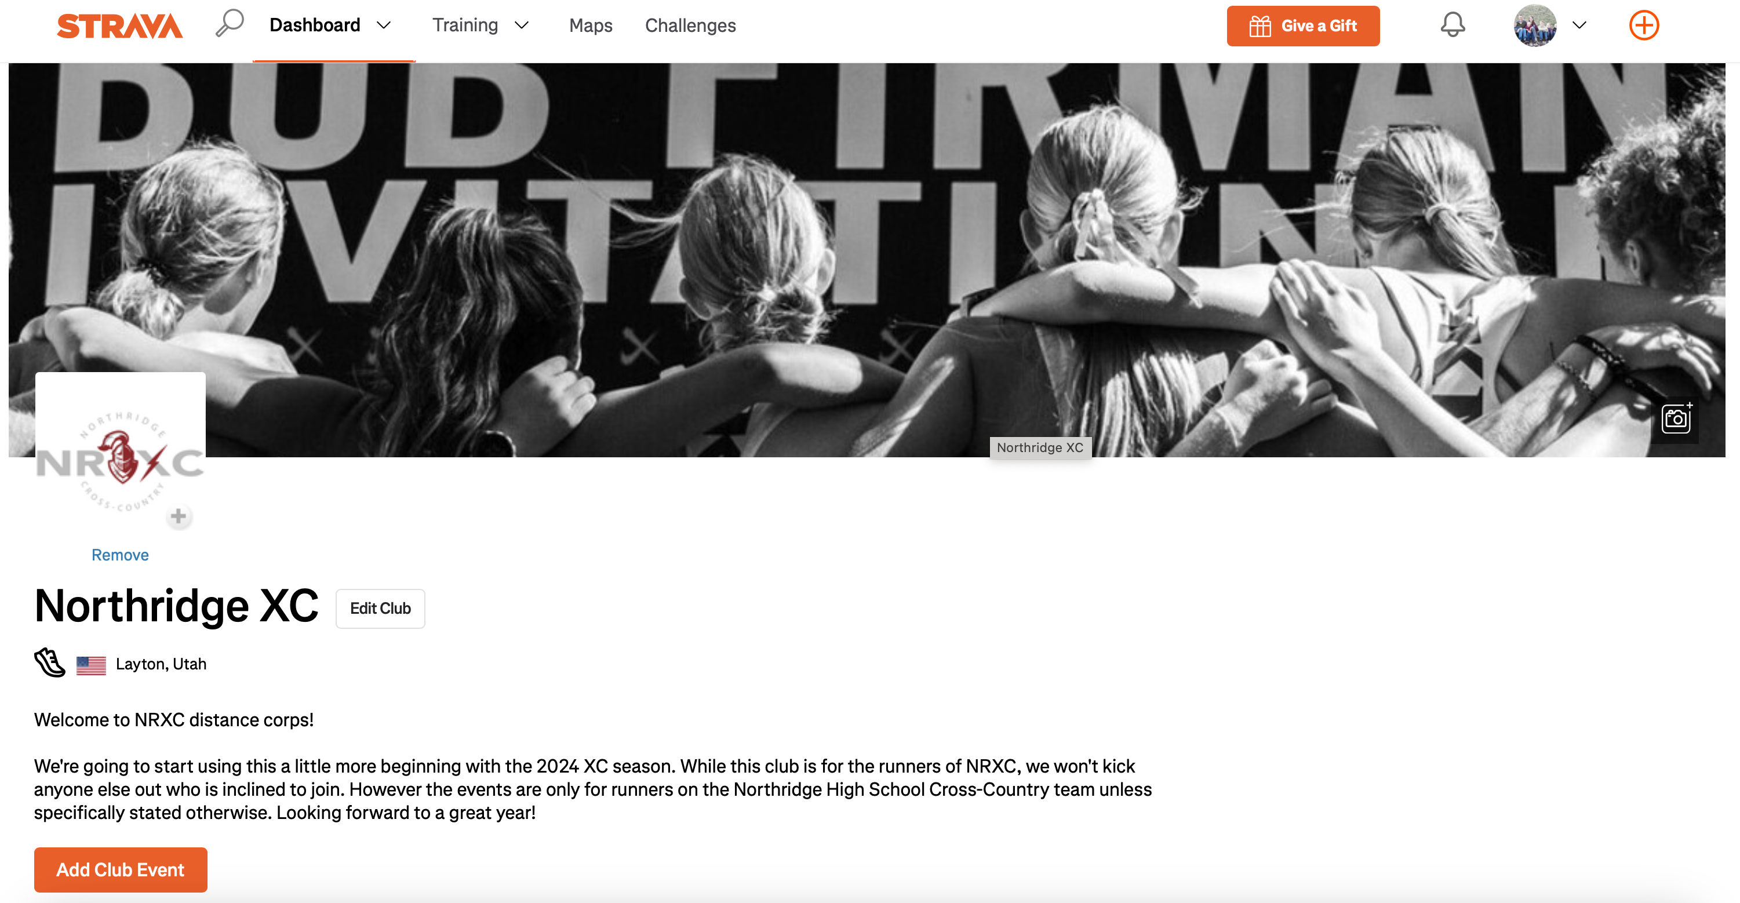

Slide 22
MILEAGE TRACKING AND REWARDS
Mileage Tracking
All athletes are expected to track their mileage daily and report it weekly
  Mileage reported more than 7 days late does not count (no end of season “mileage dumps”)
Mileage Not Tracked in Compliance with the Above Does not Count for Rewards Program
  Designed to create good training habits
  Encourages coach athlete communication
Mileage Rewards Program
A fun bonus, not something everyone should feel like they should earn every year
  Newer runners will not (and SHOULD NOT) hit some of the targets
Prizes given out based on mileage run AND properly reported
    Mileage club shirts
    Prize for highest mileage (TBD)
Higher targets adjusted for boys and girls
    Boys (200, 400, 500)
    Girls (200, 300, 400)

Slide 23
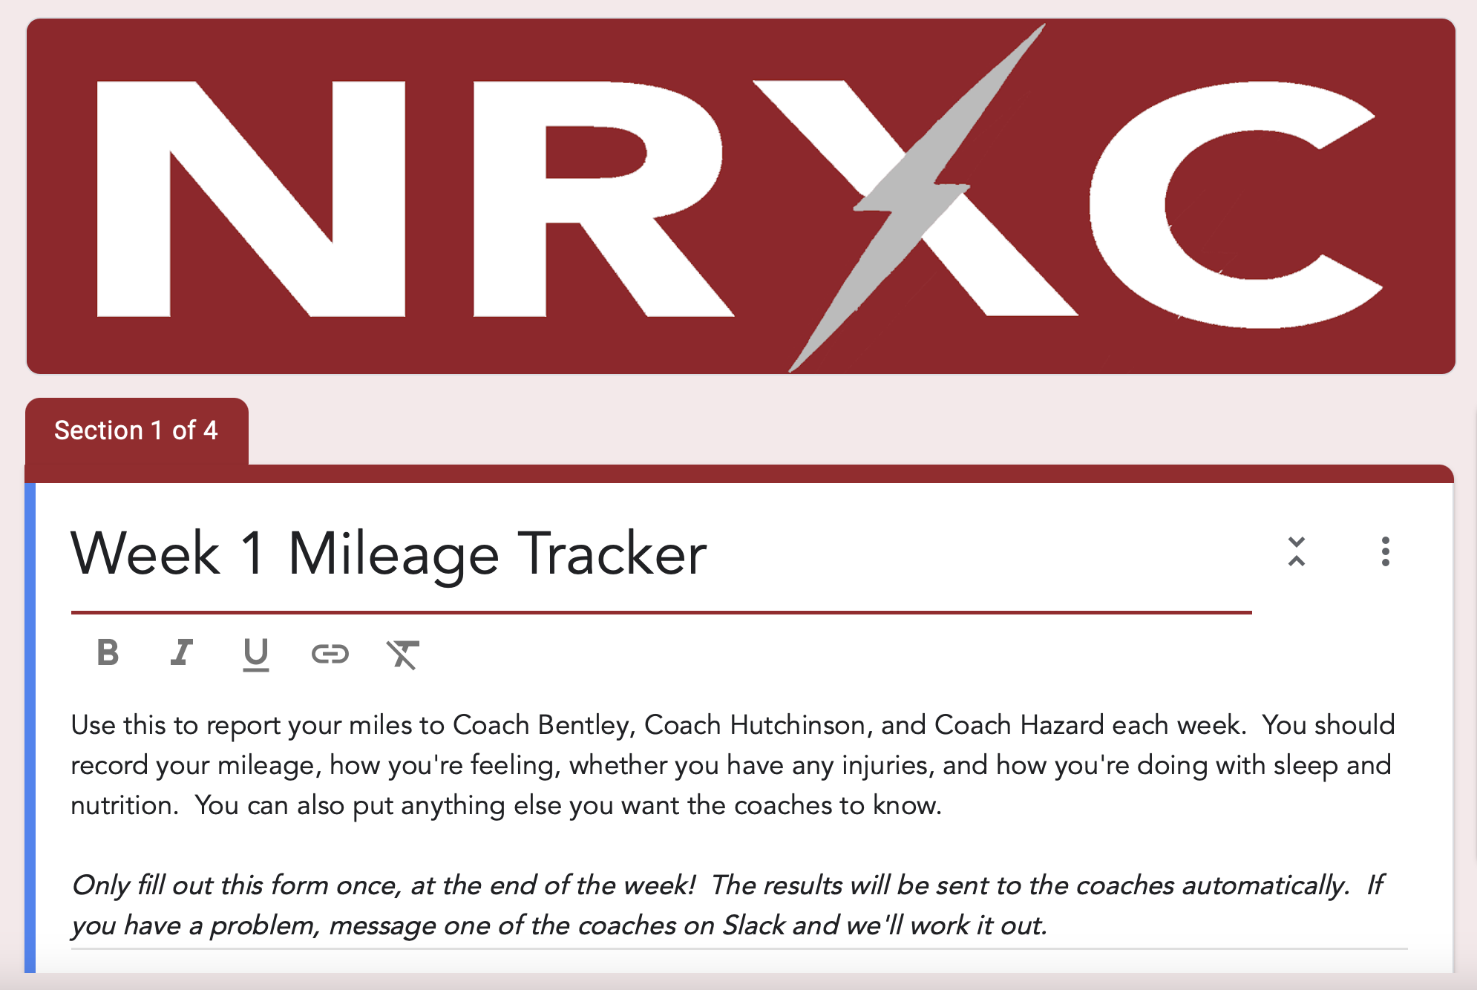

Slide 24
FUNDRAISING
Coach Hazard will be spearheading fundraising efforts again this year.
  We had success with the Fat Boy fundraiser last summer.
  My company will match again, up to $5,000(!)
  Donations and other fundraiser ideas welcome.

Slide 25
CROSS-COUNTRY CAMP
July 23-26th
  Usually leave around 11:00 AM Wednesday morning and return by Saturday afternoon
Location: Camp Lomondi
  Ogden Valley
Fun and Team-Building
  Running, talent show, games, goal setting, and lots of good food
Not Required
  Attendance is encouraged for those who qualify, but is not required
  Athletes can go for partial week if parents pick them up early/bring them up late (and communicated in advance)
Will Need Parent Volunteers
  Number TBD, but it is a great time
  Can be entire week, or partial
Travelling as a Club
  School district procedures not required
Cost
  TBD, but likely ~$120
Mileage Requirement
  120 summer miles by start of camp
  Not designed to limit attendance but to ensure all can fully participate
More Details to Come

Slide 26
VOLUNTEER OPPORTUNITIES
Thank You!!
Cross-country summer training is an ambitious undertaking
We want to make it fun for the kids and rely heavily on parent support
Thank you, thank you, thank you!!!!
Volunteer Opportunities
Summer team breakfasts
Driving for team runs
Coach catch
Fundraising help
Pineview day
Cross-country camp
Pasta dinners (in-season)
Out of state meet travel, lodging, and food coordination
Awards dinner & senior recognition
Social media accounts

Slide 27
NUTRITION AND HYDRATION
Nutrition
Eat a lot!
  Growing kids with a high training load need a lot of calories
  If they are training regularly, it is hard for them to eat too much
  Speed requires power, and power requires calories
Add in rather than cut out foods
  Discourage focusing on macros and cutting out fats, carbs, or sugars
  Protein for recovery
Female athlete health
  Relative Energy Deficiency in Sport
  Amenorrhea
Hydration
Bring your water bottle!
  Even though, during the summer, we train in the morning, it can still get hot
  We will generally NOT have water available at runs beyond what the kids bring in their bottles
Post-Workout Fueling
It is good idea for kids to get in calories as soon as they can after finishing their runs
  Does not have to be immediate
  Shouldn’t wait for the next meal
  Better something than nothing
“Start the recovery clock”

Slide 29

NUTRITION AND HYDRATION (CONT)
“Good for a Girl: A Woman Running in a Man’s World”
  An excellent book by Lauren Fleshman
  We provide a copy free of charge for all female athletes
  I encourage parents to read it
“Dear Younger Me”
  If you can’t read the book, read this essay by Ms. Fleshman, which deals with some of the same topics
  Can be easily found with a Google search
Talk to us if you see us doing something that creates a negative culture around food

Slide 30
ENCOURAGEMENt & SUPPORT
Be positive about their training and racing.
Praise effort rather than results.
Encourage and help facilitate good sleep habits.
Encourage diligence in completion of homework and other commitments.
Help treat injuries promptly.
Encourage appropriate nutrition and help supplement when necessary.

Slide 31
A FEW FINAL THINGS
GroupMe/Email List Signup
  Signup with your name, child’s/children’s name, phone number and email
  We will add you to GroupMe and the team email list
  Team Website
  http://www.northridgexc.com
Volunteer Signup Sheets
  Various signups are over on the table and you can sign up for whatever now
  I will update them and put them online as well so you can sign up later, too
Parent Survey
  I would love for you to fill this out
  Not required, but very helpful as I try to learn what I’m doing

Slide 32


Slide 33
PARENT TO-DO LIST
Signup for GroupMe & email list
Pick up flyers
Visit the website!
  www.northridgexc.com
Round up equipment
  Shoes, clothing, watch, water bottle
Complete parent survey
  Complete parent survey
Register My Athlete
  Get your kids signed up on RMA!
Watch for team store
  I’ll announce when it’s open; be ready to get your orders in
Check volunteer signup options

Slide 34
ATHLETE TO-DO LIST
Get set up on Band
  Download and install the Band app
  Create account
  Join “Northridge Cross-Country”
  Join ”Lads” or “XC-Girls” subgroups
Pick up athlete flyer
Visit the website!
  www.northridgexc.com
Round up equipment
  Shoes, clothing, watch, water bottle
Complete the athlete Survey
Complete your academic work!
  Make sure you’re eligible!
Invite a friend to come with you!
Rest until June 2

Slide 35


THANK YOU! WE’ll STAY AND ANSWER QUESTIONS
Athlete Survey
Parent Survey

