Slide 1
2024 Summer Parent Meeting

Slide 2
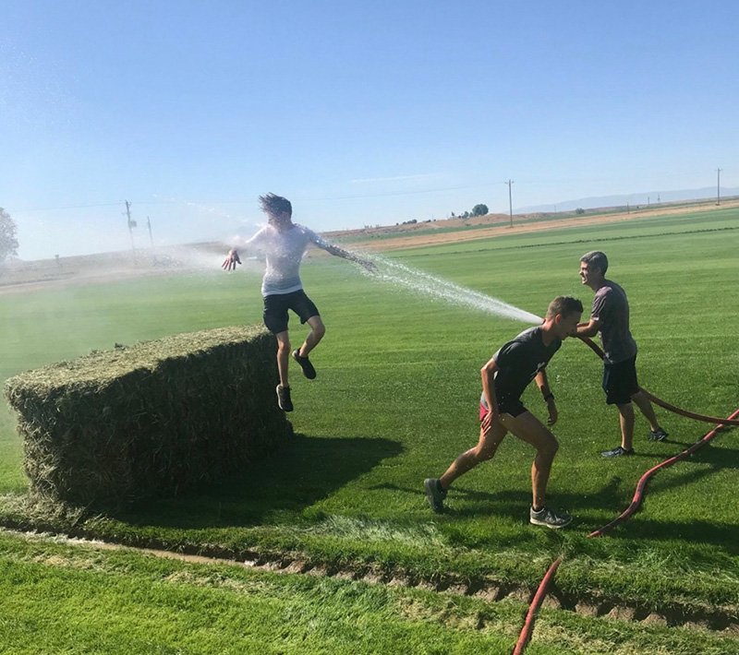
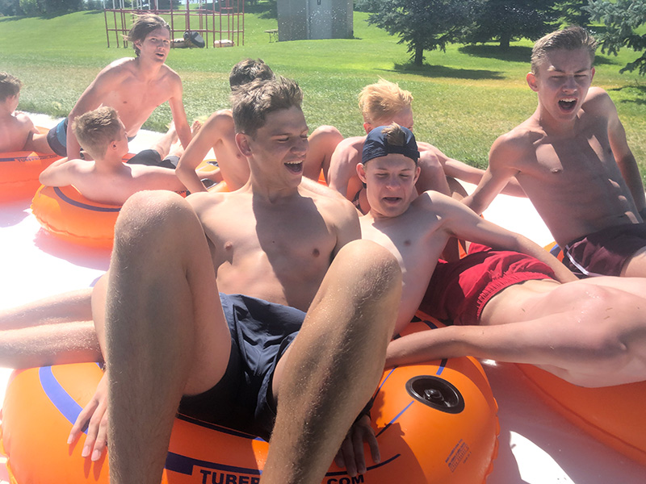
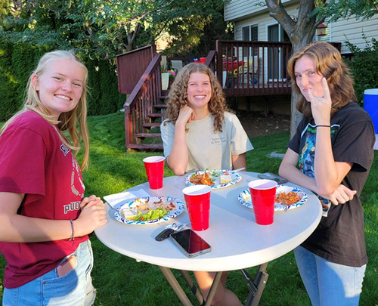
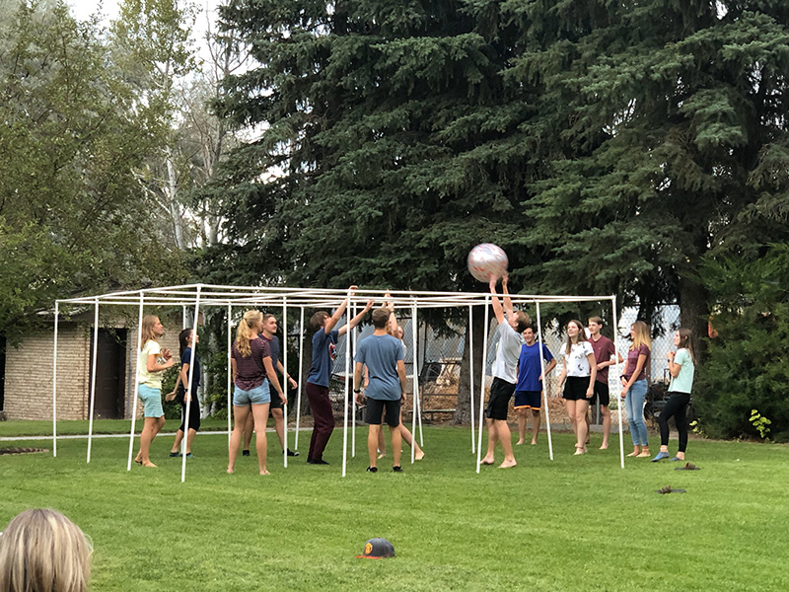
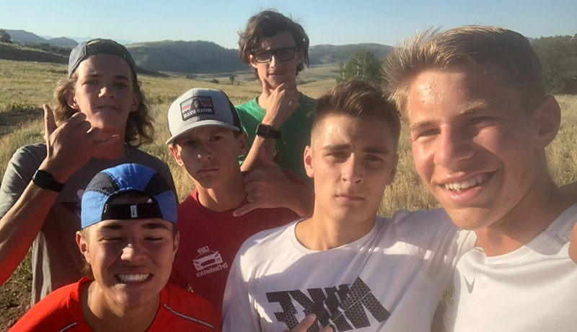

Slide 3
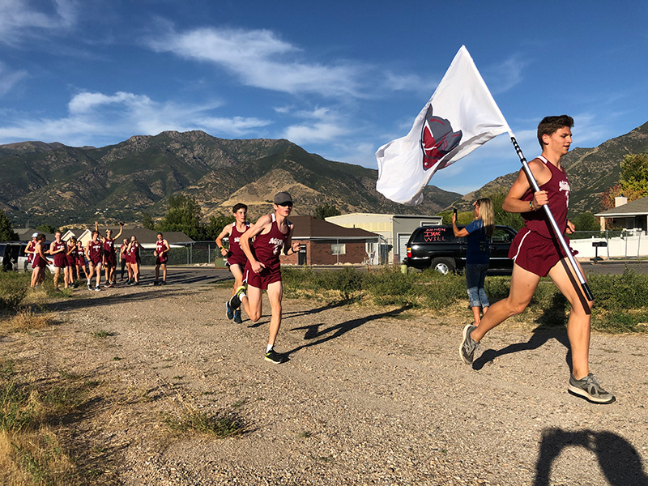
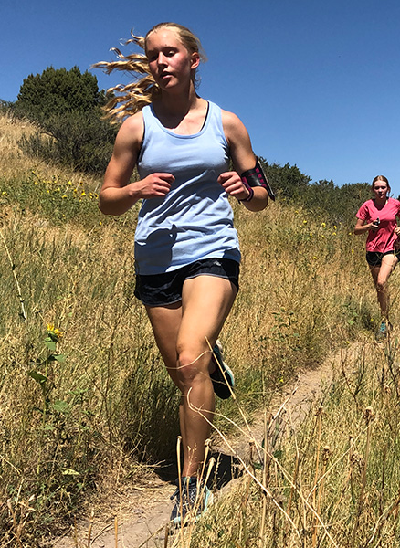
And we run, too…

Slide 4
Introductions
Coaches
Coach Bentley
Coach Hutchinson
Captains
Bella Rynearson
Lexy Cluff-Baylon
Lillie Haraala
Lily Griffith
Aaron Eskelson
Nate Eskelson
Carson Fershtut
Jordan Jensen

Slide 5
ALL INFORMATION WILL BE POSTED ON THE TEAM WEBSITE: http://www.northridgexc.com/PARENT-MEETING-FILES/
ELIGIBILITY | COMMUNICATION | TEAM FEES | EQUIPMENT | SUMMER TRAINING SCHEDULE & EXPECTATIONS
FUNDRAISING | CROSS-COUNTRY CAMP | OUT-OF-STATE MEETS | VOLUNTEERING | KEY DATES &. CHECKLISTS
NUTRITION & HYDRATION | ENCOURAGEMENT AND SUPPORT

Slide 6
ELIGIBILITY
Academic Eligibility
Based on prior term grades (so, 4th term 2023-2024)
Must have had a GPA of at least 2.0 during the last term AND
Must not have had more than one F grade.
Please come talk to me if you think there may be issues. It’s better to get out in front of things when possible.
Age Eligibility (Summer Training)
Anyone who is going into 8th grade or higher is welcome to come run during the summer, but they cannot compete with the team until they are in 9th grade.
Age Eligibility (In-Season Practice & Competition)
9th-12th graders can practice and compete with the team during the season.

Slide 7
COMMUNICATION
Parents (GroupMe)
Athletes (Slack)

Slide 8
TEAM FEES
Summer Training
No fee to participate.
This may change in future years.
Optional summer t-shirt
Cross-Country Camp
Will discuss more later
4 day/3 night camp
Cost likely around $120
In-Season Team Fee
Exact amount undetermined, probably around $150 total
Not assessed until start of the season
Out of State Meets
These meets are optional
Athlete responsible to cover travel, lodging, and food costs

Slide 9
EQUIPMENT
Required Equipment
Running shoes
Must be running specific
Do not have to be fancy
Don’t need more than one pair of shoes
Don’t need spikes
Financial assistance available
Training clothes
Do not need to be fancy or expensive.
T-shirt, tank top, shorts, sports bra for female athletes
Water bottle
Watch
Does not need to be a GPS watch but must be able to time intervals
Optional Equipment
Summer training shirt
Optional
We brought a sample. Order by June 9
Team gear
Team store (will notify when it opens)
Nothing required
Season’s use of uniform for competition will be included in the team fee
Other running accessories
Running socks
Massage gun, foam roller
Heart rate monitor
Hats, sunglasses, socks

Slide 10
SUMMER TRAINING (RUN SCHEDULE)
Team Runs
Meet Monday through Friday
Start June 3, 2024, 7:00 AM @ NHS
Variable locations
Schedule will be posted on the website
Optional Saturday Long Run
Every other week; variable locations
Will sometimes meet at NHS to carpool
Sunday is a Rest Day
Other Activities
Coach catch, Relay fundraiser, Scavenger hunt,. Pineview day
Individual Training
Saturday
On weeks with a team long run, optional to join
On weeks without a team long run, athletes train on their own or in a group with runners of their same gender
Sunday is a Rest Day
Seriously! We want them to rest
Talk to me if individual adaptation is required

Slide 11
SUMMER TRAINING (STRENGTH SCHEDULE)
Strength Training (for runners??!)
Essential for injury prevention
Performance enhancing
Develops well-rounded athleticism
Does not have to be lifting weights
Does not have to be long or super intensive
Not trying to turn them into weightlifters or stunt growth
Schedule
Designed Sessions
Athletes should do programmed sessions from the team
NHS Weight Room
We have the weight room reserved after practice on Tuesdays and Thursdays through the summer for team strength work
Bodyweight Alternatives
We will have an alternative bodyweight program that can be done at home
30-45 Minute Sessions

Slide 12
Summer TRAINING (EXPECTATIONS)
Attendance & Participation
When in town and available, I expect athletes to be at team training sessions
Be on time!
We understand that jobs, vacations, and other obligations will require missing training
Varsity runners are expected to attend team Saturday long runs
Communicate!
Speed & Mileage
No requirement that you run a certain pace or mileage
We will evaluate runners during the first week of training, meet with them, and jointly set mileage goals for the summer
Strength Training
All athletes do strength training
Runners hate it, but it is a difference maker
Tracking Mileage and Communication
Athletes are expected to track mileage daily and report it weekly (required for XC camp and mileage rewards)
Each athlete will have a Google spreadsheet to use to report mileage
Each athlete will have an assigned day each week to meet with a coach after practice and discuss the last week’s training
Without regular communication to coaches, it is difficult for us to coach effectively

Slide 13
SUMMER TRAINING (SAMPLE MILEAGE TRACKER)

Slide 14
SUMMER TRAINING (STRAVA)
Strava is an app used to track endurance activities such as running or cycling
I encourage all team members to use Strava
It’s helpful for coaches to keep track of what athletes are doing
It’s helpful for athletes to track progress
It’s fun for most, but if it starts causing anxiety athletes can stop using it
You can use it without a GPS watch
We have a team Strava group

Slide 15
MILEAGE TRACKING AND REWARDS
Mileage Tracking
All athletes are expected to track their mileage daily and report it weekly
Mileage reported more than 7 days late does not count (no end of season “mileage dumps”)
Mileage more than 10% of assigned mileage for that week doesn’t count
Mileage Not Tracked in Compliance with the Above Does not Count for Camp or Rewards Program
Designed to create good training habits
Encourages coach athlete communication
Mileage Rewards Program
A fun bonus, not something everyone should feel like they should earn every year
Newer runners will not (and should not) hit some of the targets
Prizes given out based on mileage run AND properly reported
Stickers, socks, shirts, and backpacks
Higher targets adjusted for boys and girls

Slide 16
FUNDRAISING
HELP!
We need help with fundraising ideas
Seriously, I need help
Overnight Relay
Currently scheduled for July 26-27
Athletes will take turns running 400m laps at the track carrying a baton with a GPS watch strapped to it
Athletes secure pledges per mile
Money raised will go to team general fund
May do a rootbeer/chocolate milk mile, or other contests
Will need parent volunteers to help chaperone
More information to come

Slide 17
CROSS-COUNTRY CAMP
August 7-10th
Usually leave around 11:00 AM Wednesday morning and return by Saturday afternoon
Location: Hull Valley Camp
Near Preston, Idaho
Fun and Team-Building
Running, talent show, games, goal setting, and lots of good food
Not Required
Attendance is encouraged for those who qualify, but is not required
Athletes can go for partial week if parents pick them up early/bring them up late (and communicated in advance)
Will Need Parent Volunteers
Number TBD, but it is a great time
Can be entire week, or partial
Parent Statements of Support
Required by school district
Cost
TBD, but likely ~$120
Mileage Requirement
180 summer miles by start of camp
Not designed to limit attendance but to ensure all can fully participate
More Details to Come

Slide 18
VOLUNTEER OPPORTUNITIES
Thank You!!
Cross-country summer training is an ambitious undertaking
We want to make it fun for the kids and rely heavily on parent support
Thank you, thank you, thank you!!!!
Volunteer Opportunities
Wednesday breakfasts at Oak Forest Park
Driving for team runs
Coach catch
Relay fundraiser and other fundraising
Pineview day
Cross-country camp
Pasta dinners (in-season)
Out of state meet travel, lodging, and food coordination
Senior Banquet

Slide 19
NUTRITION AND HYDRATION
Nutrition
Eat a lot!
Growing kids with a high training load need a lot of calories
If they are training regularly, it is hard for them to eat too much
Speed requires power, and power requires calories
Add in rather than cut out foods
Discourage focusing on macros and cutting out fats, carbs, or sugars
Protein for recovery
Female athlete health
Relative Energy Deficiency in Sport
Amenorrhea
Hydration
Bring your water bottle!
Even though, during the summer, we train in the morning, it can still get hot
We will generally NOT have water available at runs beyond what the kids bring in their bottles
Post-Workout Fueling
It is good idea for kids to get in calories as soon as they can after finishing their runs
Does not have to be immediate
Shouldn’t wait for the next meal
Better something than nothing
“Start the recovery clock”

Slide 21
NUTRITION AND HYDRATION (CONT)
“Good for a Girl: A Woman Running in a Man’s World”
An excellent book by Lauren Fleshman
We provide a copy free of charge for all female athletes
I encourage parents to read
“Dear Younger Me”
If you can’t read the book, read this essay by Ms. Fleshman, which deals with some of the same topics
Can be easily found with a Google search
Talk to us if you see us doing something that creates a negative culture around food

Slide 22
ENCOURAGEMENt & SUPPORT
Be positive about their training and racing.
Praise effort rather than results.
Encourage diligence in completion of homework and other commitments.
Help treat injuries promptly.

Slide 23
A FEW FINAL THINGS
GroupMe/Email List Signup
Signup with your name, child’s/children’s name, phone number and email
We will add you to GroupMe and the team email list
Cross-Country Camp Support
We need 80% support for camp to happen
I will leave, and if you would fill it out, that would be great
Volunteer Signup Sheets
Various signups are over on the table and you can sign up for whatever now
I will update them and put them online as well so you can sign up later, too
Parent Survey
I would love for you to fill this out
Not required, but very helpful as I try to learn what I’m doing

Slide 24
PARENT TO-DO LIST
Signup for GroupMe & Email List
Round Up Equipment
Shoes, clothing, watch, water bottle
Complete Cross-Country Camp Survey
Complete support survey
Complete Parent Survey
Complete parent survey
Register My Athlete
Get your kids signed up on RMA!
Watch for Team Store
I’ll announce when it’s open; be ready to get your orders in
Check Volunteer Signup Options

Slide 25
THANK YOU! WE’ll STAY AND ANSWER QUESTIONS

